Slide 1

Moneylending business in Vietnam
09.02.2017

Slide 2
Executive summary
Vietnamese Money Lending Market is one of the most promising due to a number of factors: large population (92M) with rising wages; extremely high mobile penetration (140%) and good overall internet penetration (41%); low competition level on PDL market (large players, namely banks&consumer finance companies focus on traditional products like Instalment, Consumer durable loans).
Money lending regulatory environment is not strict. There is no official interest cap regulation (though campaign against excessive rates pursued by authorities) and no specific advertising&collection restrictions. This fact is proven by a number of fintech online lending startups recently launched in the market.
We can achieve outstanding results with our reasonable requirements, really online credit decisioning (with average TAT not exceeding several hours), Pure online credit contract conclusion procedure and clear product features with EIR of approx.370% per annum.
Modern proven advertising practices will allow us to keep Marketing acquisition cost at low level ($12).
Sales …
Financial results…
Our main challenge lays is Operational excellence sphere, meaning continuing automating sales and customer support business processes and reducing total cost per loan.

Slide 3
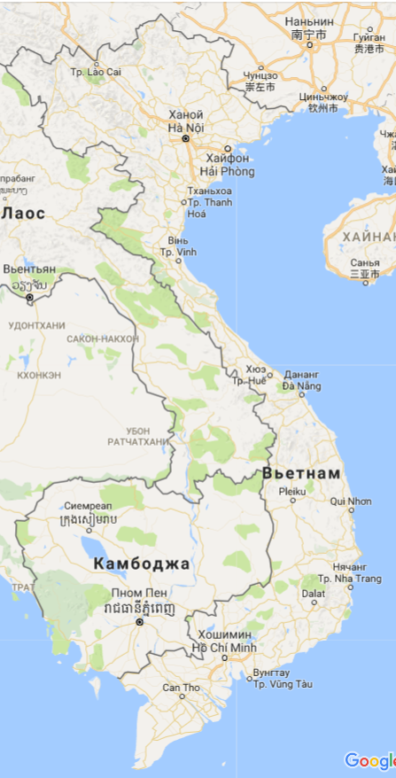
1.1 General market information*
Territory: 332K sq.km.
Population has reached 92M (2013).
Official language Vietnamese.
Average monthly wage is $210 (2012).
GDP average CAGR in 2013-2019 expected to be 6,1%.
GDP Per Capita is $2,3K (2015).
Internet penetration is relatively high – about 41%.
Mobile penetration is high – at the level of 140%.
Bank account penetration is 21% (2014).
Credit card penetration 2%.
Debit card penetration 15%.
Online banking penetration - 44% (2014).
Only about 20% of citizens at least once used bank services.
* Data sources: World Bank, McKinsey, Euro Monitor Consumer Loan Lending, UN statistics, Economist Intelligence Unit, The Banker.

Slide 4
1.2 Consumer finance industry overview
Consumer finance industry had started active development in Vietnam only approx.5-6 years ago but already reached the level of 20% growth per year.
Number of active licenses*:
42 banks;
48 foreign banks branches;
16 finance companies (FC).
Among the most active players in consumer finance are “Home Credit, “FE credit” (by “VPBank”), “Prudential” and others. Those companies are proposing Consumer durable loans, Instalment loans, Credit cards.
Even though banks officially can propose the whole retail product line to individual customers, SBV currently is requires obtaining FC license for consumer finance business.
Currently new bank and FC licenses issuance by SBV is stopped due to ongoing market restructuring.
POS-lending, Cash loans and Credit card market segments are at middle stage of development.
Due to unclear and partially out of date regulation non of the official credit institutions are using Pure online business model.
We see the niche in the online lending part of consumer finance market . We have excellent opportunity to get substantial share of the market with our innovative (for VN) Pure online business model.
* Data sources: Link 1, Link 2, Link 3

Slide 5
1.3 Licensing options overview
# | Parameter | Bank | Finance company (FC) | Microfinance institution (MFI) | Public credit fund (PCF) | Pawnshop (PS) | Peer-to-peer platform (p2p)
1 | Main purpose | Full-range banking activity for retail and corporate banking | Specialized form for specific consumer finance activity | Specialized form for microfinance activity – work with mass segment | Specialized self-steered form for small size consumer finance and SME activity | Collateralized loan granting | Facilitating individual investors and borrowers to find each other, make credit decision and process loan granting
2 | Regulator | State Bank of Vietnam (SBV) | State Bank of Vietnam (SBV) | State Bank of Vietnam (SBV) | Local authorities | City/Province people committee, Local police | -
3 | Min.capital requirements | $150M | $25M | $250K* | From $5K for every ward (limited geo coverage) | $0,1K | $0,1K
4 | Max. foreign capital share | 100% | 100% | 49% | 0% | 0% | 100%
5 | Possibility to grant loans to individuals | Yes, all the products | Yes, all the products | Yes, except credit cards | Yes, except credit cards | Yes, collateralized loans only | Yes (via individual investors)
6 | Possibility to collect deposits from individuals | Yes | Yes (requires additional SBV decision) | Yes (requires additional SBV decision) | Yes (from members only) | No | Yes (in the form of attracting individual investors)
7 | Comments |  | Specified by SBV form for conducting (“risky”) consumer finance business . Number of licenses issued currently is limited | Social, Charity fund or other NGO required to be one of the obligatory founders of MFI with min.25% share | Min. number of members 30, all VN citizens. All members have equal voting rights in determining PCF management and policy. PCF is allowed to work in specific district only | License can be issued to the local citizen only. Recent tightening requirements have been issued in 2016. | There is no specific license required for conducting p2p activity. P2p platform itself can be organized in the form of usual legal entity with “Financial consultancy” scope of activity.
Optimal choice to start operations is a Pawnshop license, as this is the most affordable option allowing to issue loans from it’s balance. Collateral requirements can be managed via creative legal solution. Regulation of Pawnshops is far not as strict as SBV’s regulation.

Slide 6
2.1 Legal setup prerequisites
We’ll start using proven “Pawnshop+LGC” legal setup as it officially allows to issue loans via Pawnshop license.
The reason of not choosing p2p option – as it seems to be more risky, while Pawnshops are controlled by local police and currently are not strictly regulated.
PS+LGC LS requires establishing 2 legal entities in VN.
Main requirements for obtaining PS license:
Scope of activity – issuing secured loans to individuals.
Shareholder – local individual (meeting official specific requirements).
Min.capital required 0.
Estimated license obtaining period – 2 weeks.
Main requirements for establishing LGC company:
Scope of activity – financial services promotion (for customers acquisition for PS).
Min.capital required ~$20K.
After reaching considerable business volumes we can consider obtaining more reliable LS option – MFI or FC.
To establish 2 legal entities and obtain appropriate licenses ~2,5 months required. Total budget required ~$20K.

Slide 7
2.2 Key regulatory points
# | Sphere of regulation | The essence
1 | New PS licenses issuance | Ongoing, no restrictions.
2 | Allowed credit products | Collateralized cash loans.
3 | APR interest cap | No, nevertheless it’s strictly advisable not to use excessive “straight” rates (approx.over 100% per annum).
4 | Advertising requirements | No specific restrictions, just basic requirements
5 | Necessity to obtain written customer’s consent for processing his personal data | Not mandatory (can be done on a website or mobile application in the form of a checkbox).
6 | Face-to-face customer’s verification (KYC procedure) | Not mandatory, might be outsourced by the third-party who will conduct face-to-face identification and ID check.
7 | Remote contract signing | Online contract signing is possible via official Digital signature using on the side of PS&LGC and “Contract conclusion via email” on customer’s side.
8 | Debt collection | No specific restrictions. Official collection activity requires obtaining separate license from local Police (min.capital requirement $90K, max.foreign capital share according to real practice 0%, specific atff requirements considering legal related education).
9 | Other specific regulation | PSs are obliged to compile customers’ documents dossier and obtain ID copy. Copy of customer’s ID should be a part of the dossier.
Pure online business model is feasible in VN.

Slide 8
2.3 Legal setup. Scheme of ownership
In VN we establish 2 local companies – LGC and PS.
PS will be established by VN citizen.
LGC will be established by VN citizen in the begging to simplify and fasten registration, later 100% shares can be transferred to FLE (will require ~2 months reregistration period).
Protection against nominee shareholders include:
Call option agreement for 100% PS shares handover to another nominee.
Legal rep. of the legal entity is a separate person.
Credit contract between FLE&NS1.
Physical control under the seal and corporate records (in RH).
Legal setup will require finding 1 local individual shareholder and 3 another local individuals to act as legal rep’s. Nominee annual fee is estimated at $... per person.

Slide 9
2.4 Legal setup. Contractual relations
FLE will provide loans to PS to provide initial investment for funding and expenses coverage and to LGC for initial expenses coverage.
FLE will conclude brand name lease agreement with LGC to obtain the margin.
LC&Borrower credit agreement will allow LC to obtain interest rate&service fee to cover credit losses and it’s operational expenses.
LGC&Borrower service agreement will allow LGC to obtain service fee to cover customer acquisition and customer support expenses.
Credit contract&Service agreement will be concluded between LC/LGC and the borrower during each loan sale and according to the following:
LGC&PS sign contracts from their side using Digital signature and send the contracts’ texts to the customer via email.
Customer signs the contracts through accessing and accepting (“concluding agreement via email”) the texts provided via www link in SMS.
In addition, to ensure customer to be explicitly informed about contracts conclusion – LGC will obtain verbal confirmation and provide the borrower scan copies of the signed contracts (containing customer’s personal data and OTP stated as a signature) via email immediately after their conclusion.
Proposed scheme will allow us to split earnings among 2 legal entities and thus mitigate regulatory risk of charging excessive fees.

Slide 10
2.5 Pure online contracts conclusion scheme
LGC and PS will use official digital signature for signing agreements with the Borrower.
To issue digital signature we plan to use certified software from “Viettel” mobile operator. Special software will be needed for both PS and LGC companies.
From customer’s side contracts will be signed using “email contract conclusion” scheme, meaning that customer will receive agreements’ texts via email, access the link to see the texts and confirm contract conclusion by sending numeric OTP to PS/LGC (provided in SMS).
To ensure customer to be explicitly informed about contract conclusion – we’ll send him the scan copies of the signed contracts (containing customer’s personal data and PS’s/LGC’s digital signatures) via email immediately after their conclusion.

Slide 11
3.1 Competitors overview
Currently we have only 1 direct competitor, focusing on PDL product – “Tima”, which’s copied our business model and started operations in 2016.

Slide 12
3.2 Proposed product parameters
# | Parameter | Value | Comments
1 | Loan amount | 1-10K VND ($43-430) | Repayment schedule – one repayment.
2 | Loan tenor | Up to 30 days
3 | Interest rate | 7,3% per annum | Charged basing on LA during the LT.
4 | Service fees | 0,98% per day | Charged by LC&LGC in the form of one-time fee for the whole LT (during initial LT).
5 | Overdue IR | 0% | Charged in the period of delinquency. Grace period – 3 calendar days.
6 | Prolongation feature | Allowed | Prolongation obtaining period const.30 days, min.payment 30% of LA, prolongation length 30 calendar days.
7 | Prolongation fee | 1,0% per day | To be charged by LGC in the form of one-time fee for the whole prolongation period.
8 | LPF | 300K VND ($13) | Max.#charges - 3. Frequency of charging 10 calendar days. Grace period – 3 calendar days.
9 | Early loan repayment | Allowed | Allowed at any time.
10 | Autocontract closure feature | Yes | Threshold value 2,5% of average LA (rounded).
EIR of the proposed product …

Slide 13
3.3 Brandname&Promotion channels
Brandname to be used – “Cashwagon”.
Website to be used – “Cashwagon.vn”, several separate landings.
We’ll use “Fast and Easy” product concept.
We’ll use the following sales propositions:
Apply within 2 minutes 24/7 without coming to the branch
Get approved within 1 (working) hour
Obtain your money on your bank account
We’ll promote product via FB and Google (in-house), local CPA partners (through cooperation agreement).
Promotion function (carrying FB and Google campaigns) will be done by RH, working with local partners and marketing materials localization will be done by local team.
Average MAC is expected at the level of $12. During the MVP period we expect it to be 2 times higher, than within 4 months will reduce to the planned level.

Slide 14
3.4 NTB sales BP
Working places to be used:
PV
DC
PV TAT – 12/4 min. for the full/confirmation-only conversations.
ID obtaining TAT – 2 hours.
Loan disbursement fee - $0,2 per loan. Loan repayment fee – 0.

Slide 15
3.5 Repeat sales BP
CC TAT – 4 min.
Loan disbursement fee - $0,2 per loan. Loan repayment fee – 0.

Slide 16
4.1 Sales. NTB sales funnel
#2 | Parameter | Value | Cum.value | Comments
1 | Visits | 100% | 100%
2 | Short apps | 28%
3 | Success apps (full apps after webSF) | 20%
4 | Approved by autochecks (after SF, BL, webscoring) | 79%
5 | Approved by PV (after PV) | 42%
6 | Finally approved (after obtaining ID) | 94%
7 | Disbursed | 100%
Annual TCR CAGR 15%.

Slide 17
4.2 Sales volumes
# | Parameter\Month | 1 | 2 | 3 | 4 | 5 | 6 | 7 | 8 | 9 | 10 | 11 | 12
1 | NTB (website) | 300 | 300 | 300 | 300 | 300 | 300 | 600 | 900 | 1200 | 1600 | 2000 | 2500*
2 | NTB (mobile app) | 0 | 0 | 0 | 50 | 50 | 50 | 100 | 100 | 150 | 150 | 200 | 250**
3 | Repeat (CC) | 300 | 500 | 700+ | 1000+ | 1000+ | 1000+ | 1000+ | 1000+ | 1000+ | 1000+ | 1000+ | 1000+
4 | Repeat (website) | 0 | + | + | + | + | + | + | + | + | + | + | +
5 | Repeat (mobile app) | 0 | 0 | 0 | + | + | + | + | + | + | + | + | +
Average LA $85/100 for NTB/Repeat.
Average LT 27/27 days for NTB/Repeat.
Repeat ratio&sales curve – see Appendix.
Prolongation ratio&curve – see Appendix.
* And so on with increasing step of 500 up to 25 000.
** And so on with increasing step in % same as for web sales.

Slide 18
5.1 Risks. Decision process, AR and SLA

Slide 19




5.2 Risks. Our risk tools and partners
World leading solution for online-fraud prevention. Creates fingerprint of client`s device, checks against internal database (>50 mln devices), run anti-fraud checks
We use access, authorized by client, to retrieve number of predictive variables from clients FB account
We are building an interface which will allow us to get expanded information about client`s e-mail
Data from clients browser and device
We retrieve open information from clients device and browser – type of operational system and it`s age, facts about logging into social media (Goggle account, Twitter, FB, YouTube, Skype, LinkedIn etc), geolocation – this information is used in our decision models
Scorecards
Quick turnover of the portfolio allows us to update the models more frequently and achieve higher efficiency

Slide 20
5.3 Collection.
5 days before DD – 2 DPD
3 DPD – 30 DPD
30+ DPD
PreCollection
3 reminder SMSs
Intensive calling campaign
Focus on prolongations (extensions) and repeats sale
Soft Collection
3-10 reminder SMSs
Intensive calling campaign
Late Collection
3 segments:
Call collection
External Debt Agencies
Field collection
Key point of collection policy - close follow-up of clients starting from 5th day before due date. We try to get full/prolongation payment as close to due date as possible, motivate client for repeat loan after full payment
In-house collection call center
Separate phone collection teams for Pre-collection, 3-30 DPD and 30+ DPD accounts
Centralized reporting, collection strategy management, IT projects (APAC HQ)
Special collection system is used for delinquent account segmentation, calls processing, SMSs and other communications management
Competing campaign between in-house collection teams and external collection agencies on 30+ DPD portfolio
Amnesty program for 30+ accounts

Slide 21
5.4 Risks. Key assumptions
After fixes of all operational issues, collection tuning, credit policy adjustments during first months of 2016, we achieved considerable improvements in risk performance by end of 2016
Current level of risk performance is sufficient for breakeven
We still put conservative forecast for key risk indicators for 2017-2021, which gives us confidence in budget fulfillment and provides additional buffer for profitability
Additional risk tools, implemented in late-2016 (first generation of score model, Iovation anti-fraud solution, Facebook and device/browser data receipt) should provide further improvements of risk indicators in 2017
FORECAST

Slide 22
6.1 Main IT assumptions
# | Parameter | Initial cost | Annual support cost | Annual dev.cost | Comments
1 | Website | $5K | 0 | $12K
2 | TS | $20K | 0 | $12K
3 | Call center solution (Webitel) | $10K | $3K | $6K
4 | Collection system | ? | ? | ?
5 | GL | $10K | 0 | $6K | Needed for 2 companies.
6 | MS Office | 0 | $150 per user | 0 | Includes Sharepoint. For CM and all managers/TLs.
7 | Mobile app | $5K | - | $6K
8 | Integrations with partners’ IT systems | $15K | - | - | Integration with Repayment partner, SMS-agent, Credit bureau
9 | Data center rent | 0 | $3K | -
10 | 1-800 phone number* | - | ? | - | For RS
11 | 1-900 phone numbers (2) | - | ? | - | For CS, Collection groups.
12 | CIB trunk (phone lines)* | $? | 0 | - | Lines are provided by local operator according to the actual needs.
13 | Notebook price | $1,5K | - | - | For CM and all managers/TLs.
14 | Desktop price (Linux) | $0,65K | - | - | For the rest personnel.
* Except traffic cost.

Slide 23
6.2 IT&Ops. Main assumptions
# | Groups pf operators | Schedule | TAT | Comments
1 | PV | 5/7, 8.00-20.00 | 12min | Using shifts
2 | TM OB+IB Repeat | 5/7, 8.00-20.00 | 4min | Using shifts
3 | CS | 5/7, 8.00-20.00 | 4min | Using shifts
4 | Soft collection G1+G2 | 5/7, 8.00-20.00 | 5min | Using shifts
5 | Field collection | 5/7, 8.00-20.00 | - | Using shifts

Slide 24
6.3 Admin&HR. VN orgchart for I phase

Slide 25
6.4 Admin&HR. Orgchart for II phase

Slide 26
6.5 Main admin assumptions
# | Parameter | Value | Comments
1 | Office rent cost | $200/sq.m. | Class B-C. non-serviced.
2 | Phase 1 office needs | ~100 sq.m.
3 | Phase 2 office needs | ~300 sq.m.
4 | Phase 3 office needs | Depending on headcount | Norms: top management 10sq.m., management 6 sq.m., rest employees 4 sq.m. per employee
5 | Furniture cost for management per working place | $500
6 | Furniture cost for the rest employees | $300
7 | Cleaning service | $1 per sq.m. | Per month

Slide 27
7.1 Investment summary

Slide 28
7.2 Volume indicators (diagrams)

Slide 29
7.3 CF

Slide 30
8. Project plan

Slide 31
Appendix 1. Draft of the website main page

Slide 32
Appendix 2. Money flow between parties

Slide 33
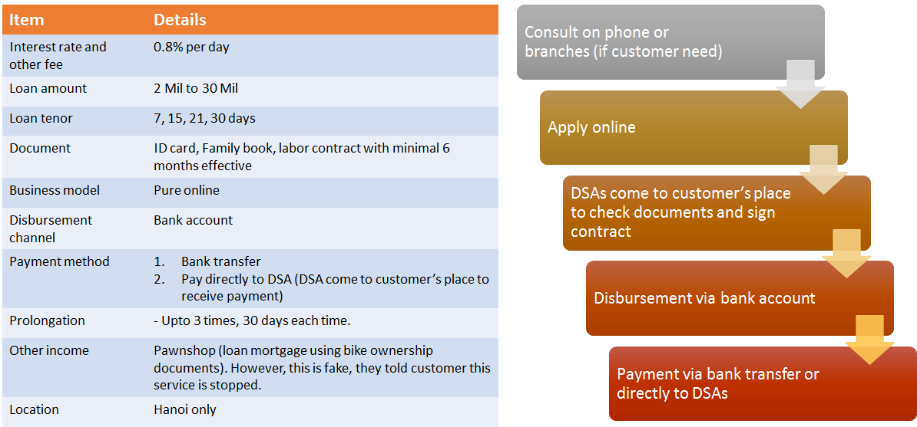
Appendix 3. Competitors review. “Tima.vn”

Slide 34
Appendix 4. IL product parameters
# | Parameter | Value | Comments
1 | Loan amount | 5-30M VND ($225-1290) | Repayment schedule – annuity monthly payments.
2 | Loan tenor | 3, 6, 12 months
3 | Effective IR | 0,3% per day
4 | Overdue IR | 0%
5 | LPF | 500K VND | Max.#charges - 3. Frequency of charging 30 calendar days. Grace period – 3 calendar days.
6 | Early loan repayment | Allowed
7 | Autocontract closure feature | Yes | Threshold value 0,5% of average LA (rounded).

Slide 35
Appendix 5. Customer support principles

Slide 36
Appendix 6. Risks. 2016 changes
Unlike classic risk management approach, which is based on monthly performance indicators, we use weekly metrics and track the performance of weekly vintages. This allows to increase the speed of reaction and make adjustments faster. As a result, starting from the scratch, we managed to build efficient risk management system during one year
59%
50%
45%
45%
42%
34%
37%
40%
26%
21%
21%
17%
8%
11%
9%
Stop Self-employed & Require document proof for Salary earners
Apply document control & daily anti-fraud triggers
New PV system
Low & Grow Campaign & Self-employed pilot
Start using Trusting Social
Simplified verification condition for customer relatives
Update policy with new verification criteria
RS check pre-approved list before selling
Deploy Collection
system
Stop DSA channel
New policy PDL 2.0 & update RS criteria
Cooperate with new collection vendors
First loan for free mass sales (March – April)
New scripts and incentive for Collection
New Repeat loan policy
New Anti-fraud rules
Problem provinces closure

